Slide 1
Inheritance in C++
CPP10671102: Programming PRINCIPLES 2

Slide 2
Objectives
What is Inheritance ?
Inheritance is Hierarchal
Advantages of Inheritance
Class Inheritance Definition
Public, Protected and Private
Inheritance and Accessibility
Public and Private Inheritance
Constructors, Destructors, and Inheritance
Rules for Building a Class Hierarchy
Over-written Functions

Slide 3
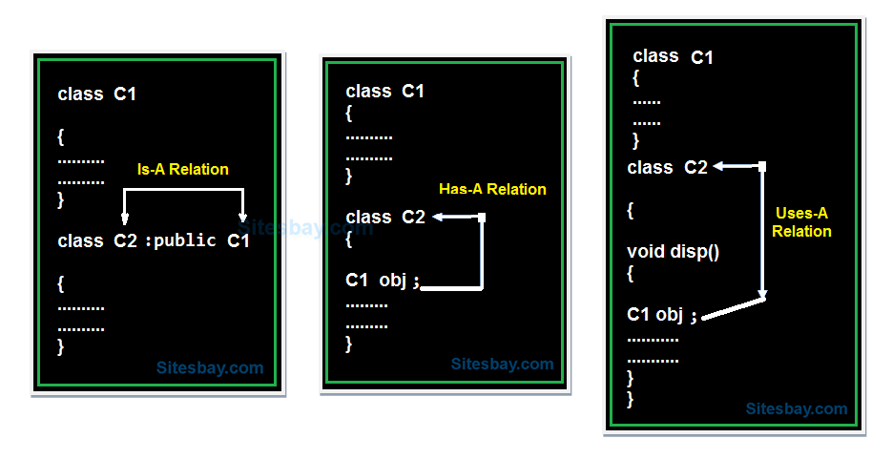
Types of Relationship in C++
Type of relationship always makes to understand how to reuse the feature from one class to another class.
In C++ programming we have three types of relationship they are.

Slide 4
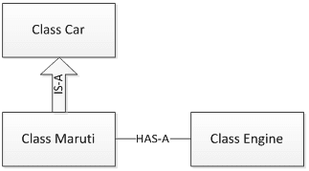
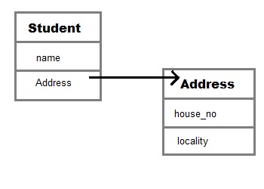
Examples
Has-A

Slide 5
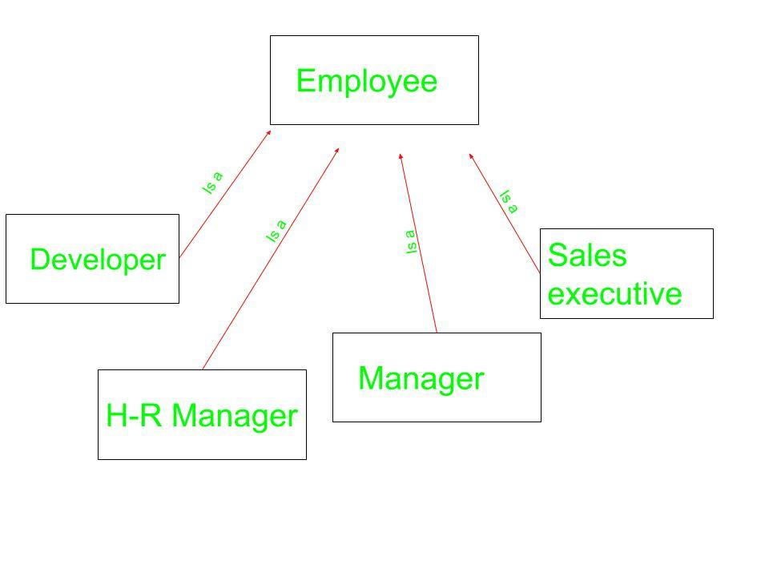
IS-A relationship – Example 1

Slide 6
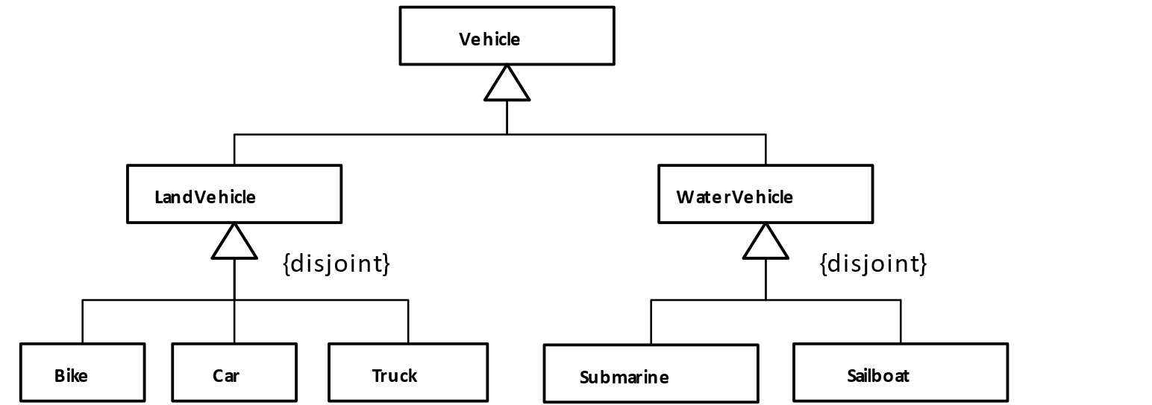
IS-A relationship – Example 2

Slide 7
What is Inheritance ??
The mechanism by which one class gets the properties of another class.
Inheritance is a meaningful way to relate two or more classes.
Inheritance implements an is-a relationship:
For example – a dog is-a animal.
a circle is-a shape
a manager is-a employee
an employee is_a person

Slide 8
Inheritance
Inheritance lets us create new classes from existing classes.
The new classes that we create from the existing classes are called the derived classes; . Is also referred to as the subclass.
The existing classes are called the base classes. Is also called the superclass.
The derived classes inherit the properties of the base classes.
Each derived class, in turn, becomes a base class for a future derived class.
A derived class can redefine the member functions of a base class, but this redefinition applies only to the objects of the derived class.

Slide 9
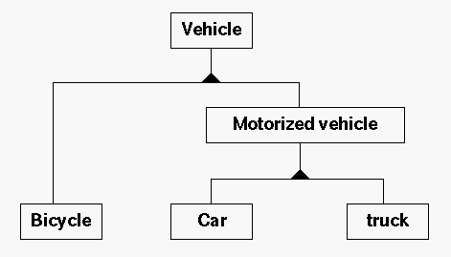
Inheritance is Hierarchal

Slide 10
Hierarchical Inheritance
Inheritance is hierarchical:
A derived class can act as a base class to a lower-level derived class.
The higher the class in the hierarchy, the more general information it contains.
The lower the class in the hierarchy, the more specific information it contains.
Attributes in a derived class overwrite the same ones in a base class.

Slide 11
Advantages of Inheritance
When a class inherits from another class, there are three benefits:
(1) You can reuse the methods and data of the existing class
(2) You can extend the existing class by adding new data and new methods
(3) You can modify the existing class by overriding its methods with your own implementations

Slide 12
Class Inheritance Definition:
New Class
Old class
class DClassId: accessId BClassId
{
DClassMembersList
};
accessId define how can the derived class access the Base class members .
Access identifier can be either public, protected and private.

Slide 13
Class Inheritance Definition:
class ClassB : public ClassA
Used a single colon (not the double colon used for the scope resolution operator) followed by the keyword public and the name of the base class ClassA.
This line says that ClassB is derived from the base class ClassA.

Slide 14
Public, protected, and private
When a class member is declared :
as public, it can be accessed by any other part of a program.
as private, it can be accesses only by members of its class.
Further, derived classes do not have access to private base class members.
as protected, it can be accessed only by members of its class.
However, derived classes also have access to protected base class members.
Thus, protected allows a member to be inherited, but to remain private within a class hierarchy.

Slide 15
Public, protected, and private
When a base class is inherited by use of
public, (default)
its public members become public members of the derived class.
its protected members become protected members of the derived class.
protected, its public and protected members become protected members of the derived class.
private, its public and protected members become private members of the derived class.
In all cases, private members of a base class remain private to that base class.

Slide 16
Inheritance and Accessibility
Access Identifier | Accessible from own class | Accessible from Derived Class | Accessible from Objects outside class
Public | Yes | Yes | Yes
Protected | Yes | Yes | No
Private | Yes | No | No

Slide 17
Inheritance and Accessibility
A class inherits the behavior of another class and enhances it in some way
Inheritance does not mean inheriting access to another class’ private members

Slide 18
Public and Private Inheritance
Class B: public A //publicly derived class
{
public:
void funct()
{
int a;
a = privdataA; //error: not accessible
a = protdataA; //OK
a =pubdataA; //OK
}
};
#include <iostream>
using namespace std;
Class A //base class
{
private:
int privdataA;
protected:
int protdataA;
public:
int pubdataA;
};

Slide 19
Public and Private Inheritance
Class A //base class
{
private:
int privdataA;
protected:
int protdataA;
public:
int pubdataA;
};
int main()
{
int a;
B objB;
a= objB.privdataA; //not accessible
a= objB.protdataA; //not accessible
a= objB.pubdataA; //OK (A public to B)
C objC;
a=objC.privdataA; //not accessible
a=objC.protdataA; //not accessible
a=objC.pubdataA;//not accessible(A private to C)
A objA;
objA.pubdataA = 10;
return 0;
}
Class C :private A //privately derived
{ public:
void funct(){
int a;
a=privdataA; //not accessible
a=protdataA; //OK
a=pubdataA; //OK
}
};

Slide 20
Public and Private Inheritance
Functions in the derived classes can access protected and public data in the base class.
Objects of the derived classes cannot access private or protected members of the base class.
The difference between publicly derived and privately derived classes:
Objects of the publicly derived class B can access public members of the base class A.
Objects of the privately derived class C cannot; they can only access the public members of their own derived class.

Slide 21
Public and Private Inheritance
When the base class is inherited by using the private access specifier, all public and protected members of the base class become private members of the derived class.
When the access specifier for a base class is public, all public members of the base become public members of the derived class, and all protected members of the base become protected members of the derived class.
When the access specifier for a base class is protected, all public and protected members of the base class become protected members of the derived class.

Slide 22
Example: base class inherited as public
#include <iostream>
using namespace std;
class base // base class
{
int i, j;
public:
void set(int a, int b) {
i=a; j=b;
}
void show(){
cout<< i << “ “ << j << “\n”;
}
};
};
class derived: public base // derivedclass
{
int k;
public:
derived( int x) {k =x; }
void showK(){
cout<<k << “\n”; ob
}
void main(){
derived ob(3);
ob.set(1,2); // access member of base
ob.show(); // access member of base
ob.showK(); // access member of drived
}
i
1
j
2
showK
k
3
set
show

Slide 23
Example:base class inherited as private
#include <iostream>
using namespace std;
class base // base class
{
int i, j;
public:
void set(int a, int b)
{ i=a; j=b;}
void show()
{ cout<< i << “ “ << j << “\n”;
}
};
class derived: private base//drivedclass
{
int k;
public:
derived( int x) {k =x; }
void showK(){
cout<<k << “\n”;
}
};
void main(){
derived ob(3);
ob.set(1,2); // Error, can’t access set()
ob.show(); // Error, , can’t access show()
ob.showk(); // ok
}

Slide 24
Example:base class inherited as protected
#include <iostream>
using namespace std;
class base // base class
{
int I;
protected:
int j;
public:
int k;
void seti(int a) { i=a; }
int geti() { return i;}
};
// inherit base as protected
class derived: protected base
{
public:
void setj(int a) { j = a ; } // j is a protected
void setK(int a){ k = a;} //k is also protected
int getj() { return j;}
int getk() { return k;}
};
void main(){
derived ob;
ob.seti(10); // illegal
cout<< ob.geti(); //illegal
ob.k = 10; //illegal
ob.setk(10);
cout<< ob.getk;
ob.setj(12);
cout << ob.getj();
}

Slide 25
Method Overriding
A subclass can modify behavior inherited from a parent class .
A subclass can create a method with different functionality than the parents method but
with the same:
Name
Return type
Argument list

Slide 26
Method overriding example
class Shape {
protected:
string name;
public:
Shape(const string & newName){ name = newName; }
void setName(const string & newName){ name = newName;}
string getName(){ return name; }
float getarea(){ return 0;} ;
};
class TwoDim:public Shape
{
protected:
float width , height;
public:
TwoDim(const string&N="unknown", float w=0,float h=0):Shape(N){
width = w; height=h;
}
float getarea(){ return 0;} ;
};

Slide 27
class Circle: public TwoDim {
public:
Circle(float radius): TwoDim("Circle",radius) { }
float getarea() { retrun width*width*(22/7.0); }
};
class Rectangle: public TwoDim {
public:
Rectangle(float width, float height ):TwoDim("Rectangle") {
this->width = width; this->height = height; }
float getarea() { return width * height ; }
};
class Square: public Rectangle {
public:
Square(float size) : Rectangle(size, size) { name = "Square";}
};
int main () {
Shape * papers[5]; Circle C1(15.0); Rectangle R1(34.0,2.0); Circle C2(2.3); Square S1(3.33); Rectangle R2(5.61,7.92);
papers[0] = &C1;
papers[1] = &R1;
papers[2] = &S1;
papers[3] = &C2;
papers[4] = &R2;
for (int k=0; k<5; k++) {
cout << "Area of "<<papers[k]->getName()<<"is " << papers[k]->getarea() << endl;
}
}

Slide 28
Overriding vs Overloading
Overriding | Overloading
Overriding happens between superclass and subclass | Overloading is present in the same class
The method signature must be the same in superclass and subclass. | The method name must be the same but method signature must be different.
Identification of the method to be called happens at runtime. | We can identify the method to be called at compile-time.
If overriding breaks, it can have adverse effects because the program will compile and run. However, the method from superclass will be called rather than subclass. | If we change method name to break overloading, the error will come at compile time. So it’s easy to fix and don’t cause much harm.
Overriding is also called Runtime Polymorphism. | Overloading is called as Compile-time Polymorphism.

Slide 29
Polymorphism
Polymorphism is the ability of an object to take on many forms.
The most common use of polymorphism in OOP occurs when a parent class reference is used to refer to a child class object.
Any C++ object that can pass more than one IS-A test is considered to be polymorphic.

Slide 30
How Overriding Works?
The method signature must be exactly the same in the superclass and the subclass.
When the instance is created, subclass constructor must be used.
At the compile time, the variable refers to the superclass. However, in runtime, it refers to the subclass object.
When the method is called on the object, it looks like the superclass method will be called. But the method is present in the subclass object, hence it’s called.

Slide 31
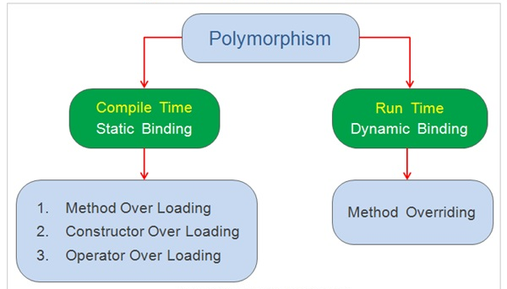
Polymorphism Types overview
Virtual methods

Slide 32
Compile time polymorphism: This type of polymorphism is achieved by: function overloading or operator overloading
Function Overloading: When there are multiple functions with same name but different parameters then these functions are said to be overloaded.
Functions can be overloaded by change in number of arguments or/and change in type of arguments.

Slide 33
// C++ program for function overloading
class Geeks {
public:
// function with 1 int parameter
void func(int x) { cout << "value of x is " << x << endl; }
// function with same name but 1 double parameter
void func(double x) { cout << "value of x is " << x << endl; }
// function with same name and 2 int parameters
void func(int x, int y) { cout << "value of x and y is " << x << ", " << y << endl; }
};
int main() {
Geeks obj1;
// Which function is called will depend on the parameters passed
obj1.func(7); // The first 'func' is called
// The second 'func' is called
obj1.func(9.132);
// The third 'func' is called
obj1.func(85,64);
return 0;
}
In this example, a single function named func acts differently in three different situations which is the property of polymorphism.

Slide 34
Operator Overloading: C++ also provide option to overload operators.
For example, we can make the operator (‘+’) for string class to concatenate two strings. We know that this is the addition operator whose task is to add two operands. So a single operator ‘+’ when placed between integer operands , adds them and when placed between string operands, concatenates them.
// CPP program to illustrate Operator Overloading
class Complex {
private:
int real, imag;
public:
Complex(int r = 0, int i =0) {real = r; imag = i;}
// This is automatically called when '+' is used with between two Complex objects
Complex operator + (Complex const &obj) {
Complex res;
res.real = real + obj.real;
res.imag = imag + obj.imag;
return res;
}
void print() { cout << real << " + i" << imag << endl; }
};
int main() {
Complex c1(10, 5), c2(2, 4);
Complex c3 = c1 + c2; // An example call to "operator+"
c3.print();
}

Slide 35
Runtime polymorphism: This type of polymorphism is achieved by Function Overriding.
Function overriding on the other hand occurs when a derived class has a definition for one of the member functions of the base class. That base function is said to be overridden.
Since print() is virtual in base class, it is called according to the type of object being referred or pointed, rather than the type of pointer or reference.
// C++ program for function overriding
class base {
public:
virtual void print () { cout<< "print base class" <<endl; }
void show () { cout<< "show base class" <<endl; }
};
class derived:public base {
public:
void print () { cout<< "print derived class" <<endl; }
void show () { cout<< "show derived class" <<endl; }
};
int main() {
base *bptr; derived d; bptr = &d;
bptr->print(); //virtual function, binded at runtime (Runtime polymorphism) (late binding)
bptr->show(); // Non-virtual function, binded at compile time
}
OUTPUT:
print derived class
show base class

Slide 36
Another example
#include<iostream> using namespace std; class Base { public: virtual void show() { cout<<" In Base \n"; } }; class Derived: public Base { public: void show() { cout<<"In Derived \n"; } }; int main(void) { Base *bp, b; Derived d; bp = &d; bp->show(); bp = &b; bp->show(); Base & x = d; // reference (nickname) x.show(); // In Derived return 0; }
OUTPUT
In Derived
In Base
Explanation:
Initially base pointer points to a derived class object. Later it points to base class object,

Slide 37
Virtual Functions and Runtime Polymorphism in C++
Consider the following simple program as an example of runtime polymorphism. The main thing to note about the program is that the derived class’s function is called using a base class pointer.
The idea is that virtual functions are called according to the type of the object instance pointed to or referenced, not according to the type of the pointer or reference.
In other words, virtual functions are resolved late, at runtime.

Slide 38
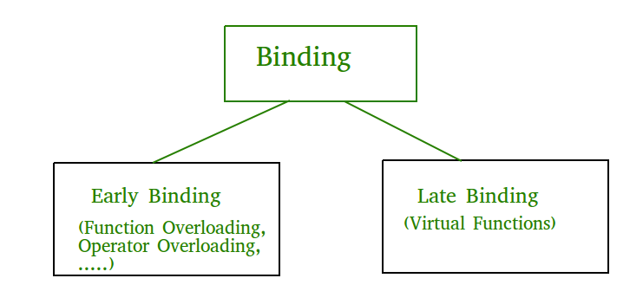
Late binding
virtual functions are resolved late, at runtime.
template

Slide 39
Example: Consider an employee management software for an organization.
class Employee { // ADT : Abstract Data Type
public:
virtual void raiseSalary()=0; // pure virtual
virtual void promote() { }
};
class Manager : public Employee { // concrete class
virtual void raiseSalary() {
/* Manager specific raise salary code, may contain
increment of manager specific incentives*/
}
virtual void promote() { /* Manager specific promote */ }
};
// Similarly, there may be other types of employees, We need a very simple function to increment the salary of //all employees .
// Note that emp[] is an array of pointers and actual pointed objects can be any type of employees.
// This function should ideally be in a class like Organization, we have made it global to keep things simple
void globalRaiseSalary(Employee* emp[ ], int n) {
Employee e;// error : abstract class
for (int i = 0; i < n; i++)
emp[i]->raiseSalary();
// Polymorphic Call: Calls raiseSalary() according to the actual object, not according to the type of pointer
}
Every type of employee may have its own logic in its class, but we don’t need to worry about them because if raiseSalary() is present for a specific employee type, only that function would be called.

Slide 40
What is the use?
Virtual functions allow us to create a list of base class pointers and call methods of any of the derived classes without even knowing kind of derived class object.
void globalRaiseSalary(Employee* emp[ ], int n) {
Employee e;// error : abstract class
for (int i = 0; i < n; i++)
emp[i]->raiseSalary();
// Polymorphic Call: Calls raiseSalary() according to the actual object, not according to the type of pointer
}

Slide 41
What are pure virtual functions?
1) Their implementation can be provided in a class where they are declared.
(But when a function is declared pure virtual, it simply means that this function cannot get called dynamically, through a virtual dispatch mechanism. Yet, this very same function can easily be called statically, non-virtually, directly (without virtual dispatch).
2) If a class has a pure virtual function, then the class becomes abstract class and an instance of this class cannot be created.

Slide 42
class S {
public:
virtual void foo()=0;
};
void S::foo() {
// body for pure virtual function `S::foo`
}
class D :public S {
public:
void foo() {
S::foo(); // Non-virtual call to `S::foo` from derived class
// ------------------------
}
};
int main() {
D d;
d.S::foo(); // Another non-virtual call to `S::foo`
S obj; // compiler error : abstract class can not be instantiated
S * p; // No error (No instantiation )
p = new S; // compiler error : new operator is responsible for instantiation
p = new D; // ok
}

Slide 43
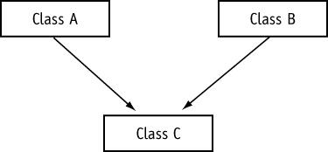
15.9 Multiple Inheritance
Multiple inheritance is when a derived class has two or more base classes

Slide 44
Example
Contents of date.h
#ifndef DATE_H
#define DATE_H
class Date
{
protected:
int day;
int month;
int year;
public:
Date(int d, int m, int Y)
{ day = d; month = m; year = Y; }
int getDay(void) { return day; }
int getMonth(void) { return month; }
int getYear(void) { return year; }
};
#endif

Slide 45
Program continues
Contents of time.h
#ifndef TIME_H
#define TIME_H
class Time
{
protected:
int hour;
int min;
int sec;
public:
Time(int h, int m, int s)
{ hour = h; min = m; sec = s; }
int getHour(void) { return hour; }
int getMin(void) { return min; }
int getSec(void) { return sec; }
};
#endif

Slide 46
Program continues
Contents of datetime.h
#ifndef DATETIME_H
#define DATETIME_H
#include "date.h" // For Date class declaration
#include "time.h" // For Time class declaration
class DateTime : public Date, public Time
{
protected:
char dTString[20];
public:
DateTime(int, int, int, int, int, int);
void getDateTime(char *str) { strcpy(str, dTString); }
};
#endif

Slide 47
Program continues
Contents of datetime.cpp
#include “datetime.h”
#include <string.h> // For strcpy and strcat
#include <stdlib.h> // For itoa
void DateTime::DateTime(int dy, int mon, int yr, int hr, int mt, int sc) : Date(dy, mon, yr), Time(hr, mt, sc)
{
char temp[10]; // Temporary work area for itoa()
// Store the date in dTString, in the form MM/DD/YY
strcpy(dTString, itoa(getMonth(), temp, 10));
strcat(dTString, “/”);
strcat(dTString, itoa(getDay(), temp, 10));
strcat(dTString, “/”);
strcat(dTString, itoa(getYear(), temp, 10));
strcat(dTString, “ “);

Slide 48
Program continues
// Store the time in dtString, in the form HH:MM:SS
strcpy(dTString, itoa(getHour(), temp, 10));
strcat(dTString, “:”);
strcat(dTString, itoa(getMin(), temp, 10));
strcat(dTString, “:”);
strcat(dTString, itoa(getSec(), temp, 10));
}
Contents of the main program, pr15-12.cpp
// This program demonstrates a class with multiple inheritance.
// NOTE: datetime.cpp must be compiled and linked with this
// file.
#include <iostream.h>
#include “datetime.h”

Slide 49
Program continues
void main(void)
{
char formatted[20];
DateTime pastDay(4, 2, 60, 5, 32, 27);
pastDay.getDateTime(formatted);
cout << formatted << endl;
}

Slide 50
Program Output
4/2/60 5:32:27

